Slide 1
Merge Sort vs Quick Sort
By:
Yeshwant Satyada – AP24110012107
Tanneeru Benhen Doondy Nikhil – AP24110010890
Sanjana Cheetirala - AP24110010892
Shaik Afrid – AP24110010873
Syed Tanveer Ahmed – AP24110010872

Slide 2
Contents
1
Introduction
6
Observation
2
Quick Sort
7
When to use
3
Merge Sort
8
Real-time ex
4
Performance
9
Summary
5
Test data
10
Conclusion

Slide 3
Introduction
Sorting algorithms are essential in computer science for organizing data efficiently.
Quick Sort and Merge Sort are two widely used divide-and-conquer sorting techniques.
Both aim to sort elements quickly, but they differ in:
  Approach and implementation
  Efficiency in various scenarios
  Memory usage and stability
Understanding their differences helps in choosing the right algorithm for real-world applications.

Slide 4
Quick Sort
Based on divide-and-conquer strategy.
Selects a pivot element and partitions the array into:
Elements less than the pivot
Elements greater than the pivot
Recursively sorts the subarrays formed after partitioning.
Time Complexity
Best | O(n log n)
Average | O(n log n)
Worst | O(n²)
Space Complexity
O(log n) (due to recursion)

Slide 5
Merge Sort
Follows divide-and-conquer methodology. Recursively divides the array into two halves until single elements remain.
Merges the divided parts in sorted order to form the final sorted array. Sorting is not in-place (requires additional memory).
Guarantees consistent performance regardless of input order.
Time Complexity
Best | O(n log n)
Average | O(n log n)
Worst | O(n²)
Space Complexity
O(log n) (due to recursion)

Slide 6
Erfomance Comparsion
P
Feature | Quick Sort | Merge Sort
Average Time Complexity | O(n log n) | O(n log n)
Worst Case Time Complexity | O(n²) (poor pivot selection) | O(n log n)
Space Complexity | O(log n) (in-place) | O(n) (extra memory)
Stability | Not stable by default | Stable
Practical Performance | Faster in real-world cases due to better cache utilization | Predictable performance, useful for large datasets
Suitability | Best for arrays and when memory is limited | Best for linked lists or when stable sort is required

Slide 7
COde implementation

Slide 8
Merge Sort
Quick Sort
Quick Sort works by choosing a pivot element and arranging the array so that elements smaller than the pivot come before it and larger elements come after it. Then the algorithm recursively repeats the process on the left and right subarrays until the entire array becomes sorted. The sorting happens within the same array by swapping elements when needed.
Merge Sort works by dividing the array into two halves again and again until each part contains a single element. Then, it merges these small sorted parts back together in order, forming a fully sorted array. It uses temporary arrays during merging to ensure the elements are placed correctly.

Slide 9
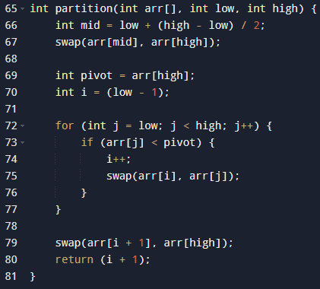
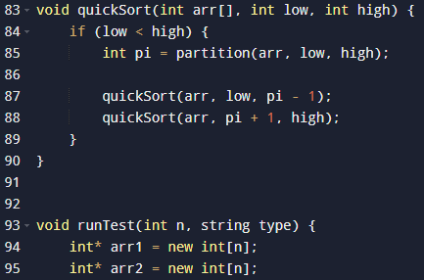
QUICK SORT FUNCTION
Quick Sort

Slide 10
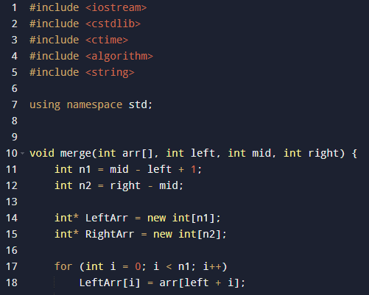
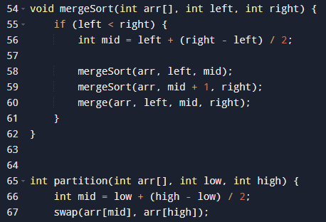
MERGE SORT FUNCTION
Merge Sort

Slide 11
OBSERVATIONS
Usorted array | Quick Sort(S) | Merge Sort(S)
[1, 2, 3, 4, 5, 6, 7, 8, 9, 10] | 0.000019 | 0.000019
[7, 7, 7, 7, 7, 7, 7] | 0.000003 | 0.000006
[3, 1, 2, 1, 5, 1, 4, 1] | 0.000007 | 0.000008
[9, 1, 8, 2, 7, 3, 6, 4, 5] | 0.000010 | 0.000009
[100, 50, 20, 40, 90, 10, 70, 30, 60, 80] | 0.000011 | 0.000010
[2, 1, 4, 3, 6, 5, 8, 7, 10, 9] | 0.000011 | 0.000009

Slide 12
OBSERVATIONS

Slide 13
nalysis
A

Slide 14
Quick sort
Quick Sort performs best when:
The input contains mixed values (not too many duplicates)
The data is partially sorted or in alternating patterns
The pivot ends up near the middle after partitioning

Slide 15
Merge sort
Merge Sort performs best when:
Input has many duplicates
There is large range variation in values
Stable sorting is required (preserves equal element order)
Extra memory is not a concern

Slide 16
Summary
Quick Sort is preferred when memory is limited and fast performance is needed on average, especially for most general-purpose unsorted data like user lists, transaction records, or ranking systems. It works efficiently in-place and is commonly used in web applications and database indexing where speed matters more than stability.
On the other hand, Merge Sort is ideal when stable sorting is required or when handling very large datasets stored on external memory such as disk drives. It is widely used in applications like sorting linked lists, organizing large files, and performing data processing in distributed systems where guaranteed performance is necessary.

Slide 17
conclusion
Both Quick Sort and Merge Sort are powerful divide-and-conquer sorting algorithms.
Quick Sort is generally faster in practical scenarios and requires less memory, making it suitable for most real-time applications.
Merge Sort ensures consistent performance and maintains stability, making it ideal for large datasets and situations where data order must be preserved.
Choosing the right algorithm depends on input characteristics, memory constraints, and the need for stability.
There is no single best algorithm — the best choice depends on the specific problem and system requirements.

Slide 18
THANK YOU

